Slide 1


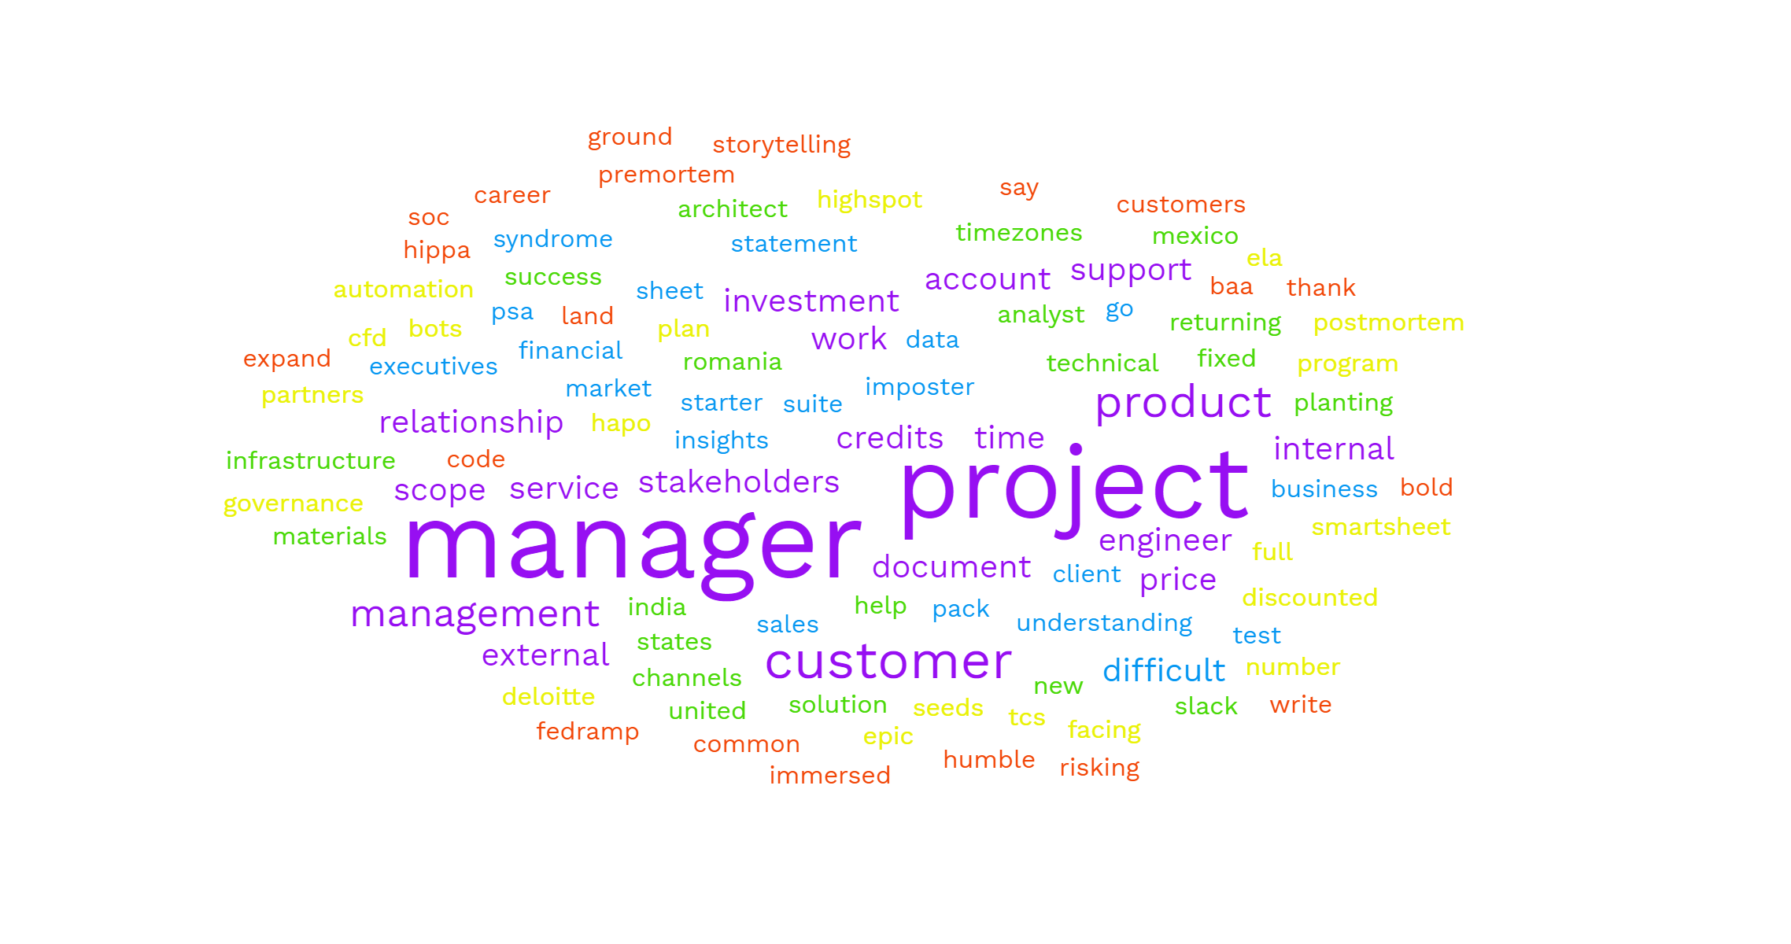

Project Management @ UiPath
-Anthony Garcia
Professional Services
Notes:
All that I wanted this talk to be – I wrote as terms and put them in a word cloud to represent the mental model I have when going about the challenges of professional services projects and where they fit in the overall goals of the company….
Word Cloud - Imposter Syndrome, Statement of Work, Financial Data Sheet, PSA, Insights, Test Suite, Document Understanding, Starter Pack, Sales, Account Executives, Go To Market, Client, Customer, Business Analyst, Solution Architect, Romania, India, Mexico, Product, Slack Help Channels, Technical Account Manager, Customer Success Manager, Product Support Engineer, Infrastructure Engineer, SCOPE, Time and Materials, Fixed Price, Returning Customer, New Customer, timezones, United States, planting seeds, internal relationship management, external relationship management, number of bots, ELA , HAPO, partners, EPIC, Deloitte, TCS, Project Manager, investment, discounted, full price, CFD, Customer Facing Document, Highspot, project plan, smartsheet, automation, program governance, investment, service credits, postmortem, premortem, HIPPA, BAA, FedRamp, SOC2, service credits, land and expand, storytelling, internal stakeholders, external stakeholders, product, product support, say thank you, difficult customers, risking career, common ground, write some code, bold, humble, immersed, fast, more hands make light work, managed vs reactionary, difficult situations, toastmasters, listen, obsessed with chess as a teen, STARS, problem, opportunity, scope, cost, time, quality, SOW, presales 2.0, engagement management, Project Manager, Project Manager, Project Manager, Project Manager, Project Manager, Project Manager, Project Manager, Project Manager, Project Manager, Project Manager🡺 used https://www.freewordcloudgenerator.com/generatewordcloud (rainbow, 100%, poppins)

Slide 2
Table of Contents
Professional Services
Who, What, Where, When, Why? How?
What is a UiPath software robot?
Who is the UiPath project manager?
Why are we running professional services projects?
What is the vision we are selling?
Where does a project manager look for help?
How do we execute projects?
When is a project finished?

Slide 3
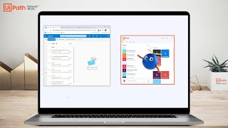
What is a UiPath Software Robot?
Professional Services
Notes:
There are ways to get practice here – toastmasters, side projects, linkedin learning, learn by fire, shadowing, get beat by someone smarter than you in chess and understand why you lost, many other ways.
Sin eater – mitigates risk

Slide 4
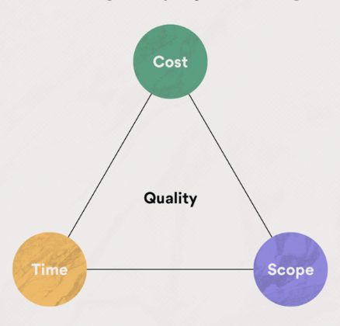
Who is the UiPath project manager?
Professional Services
One throat to choke…
A generalist
A communicator
A relationship builder
An expectation setter
A best options giver
A storyteller who is well versed in the UiPath story –> Presales 2.0
A Dungeon Master
Curious, interested, competent at project management toolset and terms
A sin eater, a meat shield
Notes:
There are ways to get practice here – toastmasters, side projects, linkedin learning, learn by fire, shadowing, get beat by someone smarter than you in chess and understand why you lost, many other ways.
Sin eater – mitigates risk

Slide 5
Why are we running professional services projects?
Professional Services
Let’s explore the product company vs services company balance argument…
To serve as a safe starting point for customers of our product…
To find ways to go deeper into providing value for a customer’s organization…
To be a “go to” to trust to solve tough problems at the brink of our platform’s current capability…
To be a gold standard for all our partners who often learn under our ‘brand’ label…
Notes:
Partners that have worked under our brand label include Accelirate Inc, Ashling Partners, Roboyo, qBotica, Alirrium, Auxis

Slide 6
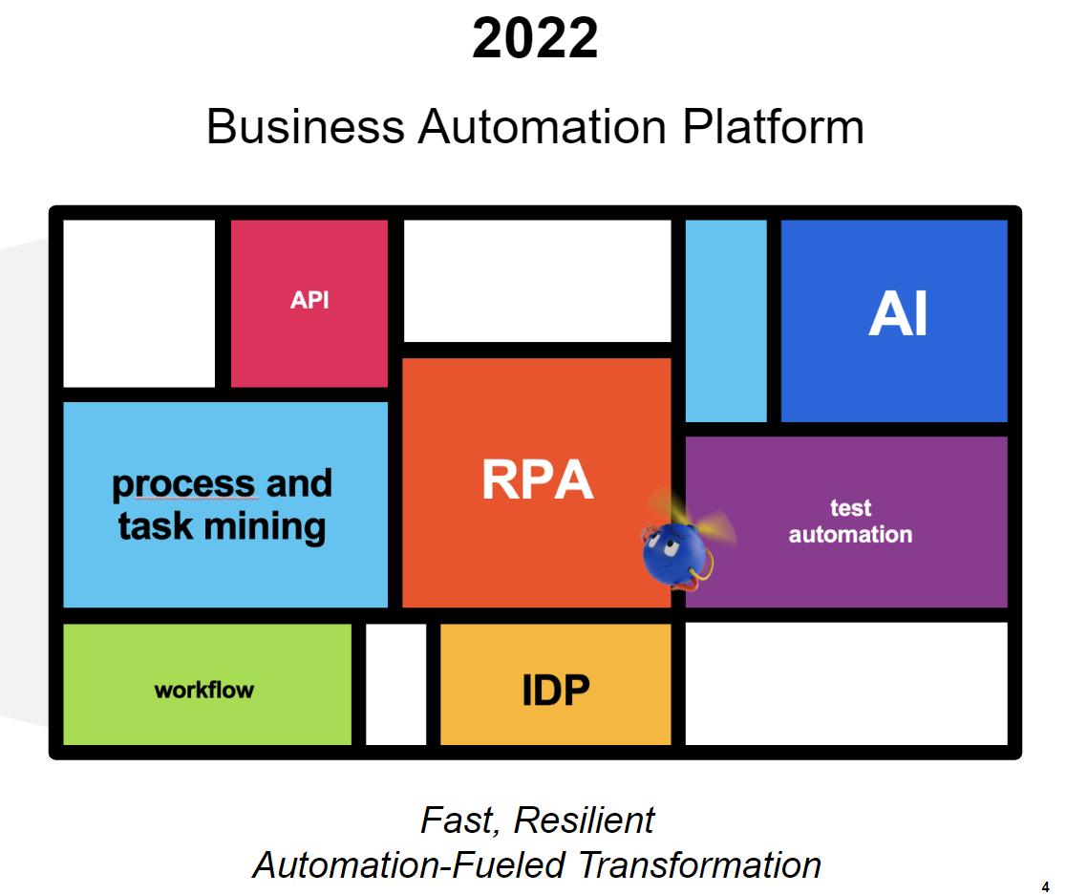
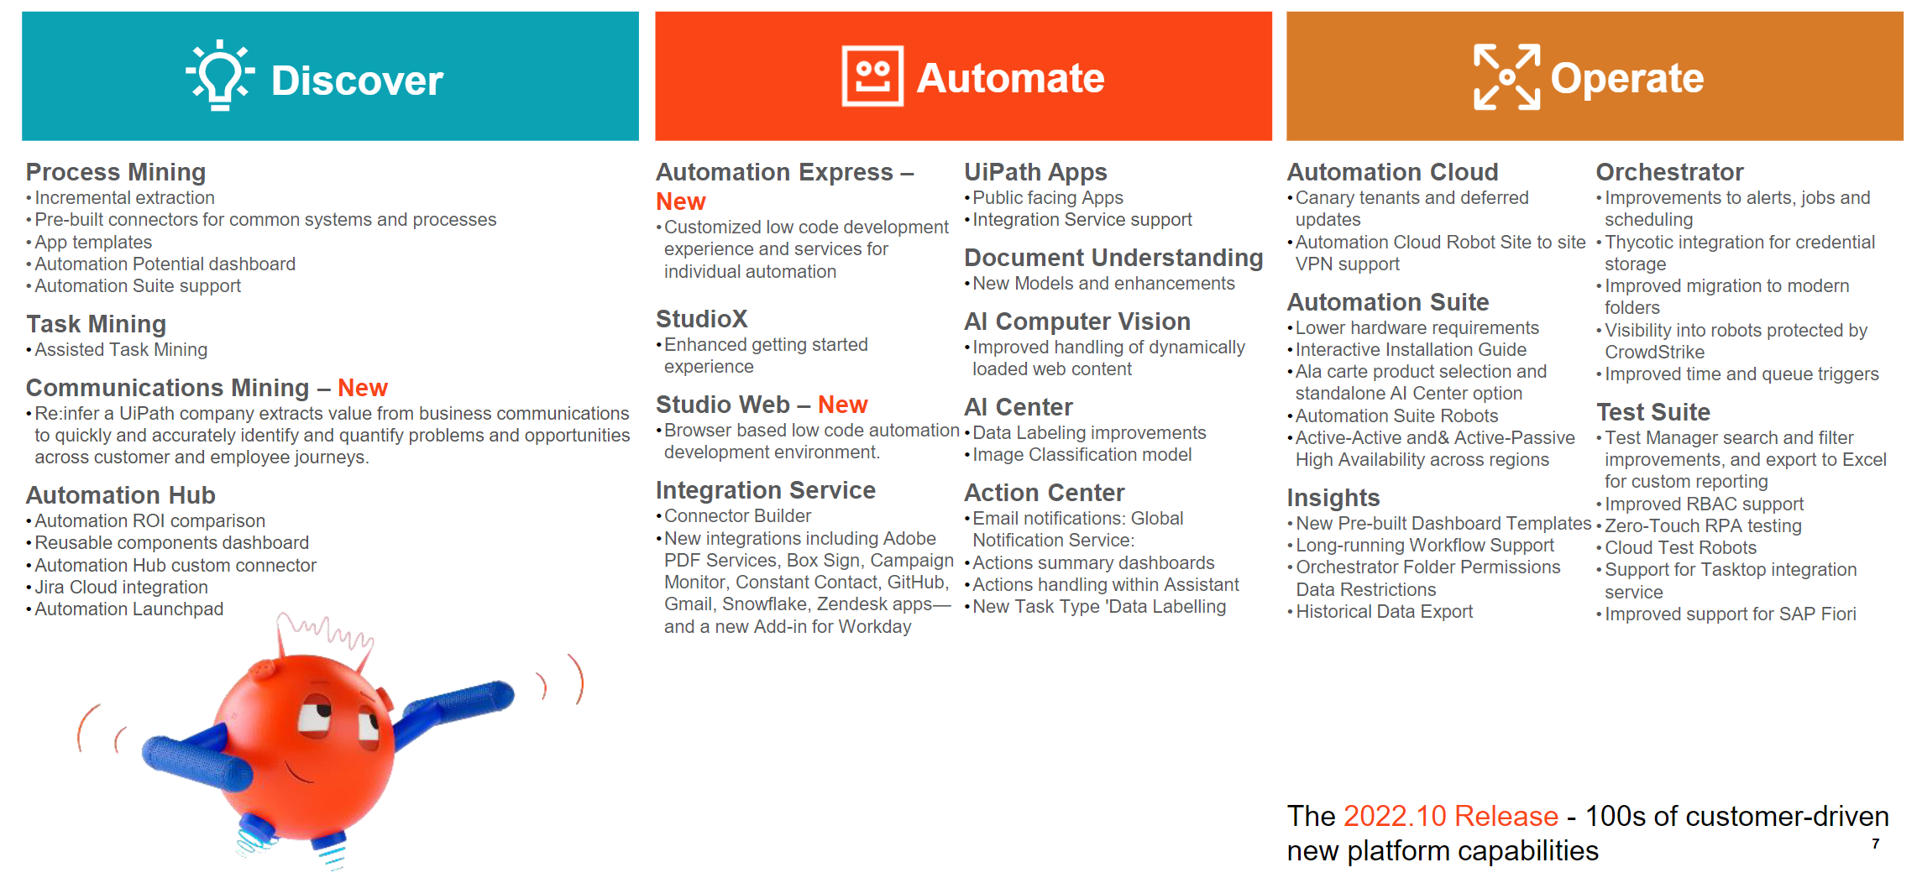
What vision are we selling?
Professional Services
Familiarize yourself with the storytelling in the main Highspot ‘CFD’ Customer Facing Document. It’s currently a 26 slide deck in every presales engineer’s playbook.
Notes:
As of 01/19/2023, currently we have a 2022.10 deck out on highspot. My friend Will Redmond and the other creatives in marketing are also storytellers. What I notice about this deck vs the 2018 deck is the absence of name dropping.

Slide 7
Where does a project manager look for help?
Professional Services
Many hands make light work… Some lifelines…
The project team and their internal contacts.
The professional services team (global)
The kindness of strangers/friends - Slack #help
The account team
The product team
The product support team
Executives
Program governance leadership
Infrastructure
Bots.
See my reference talk on Internal Stakeholders.

Slide 8
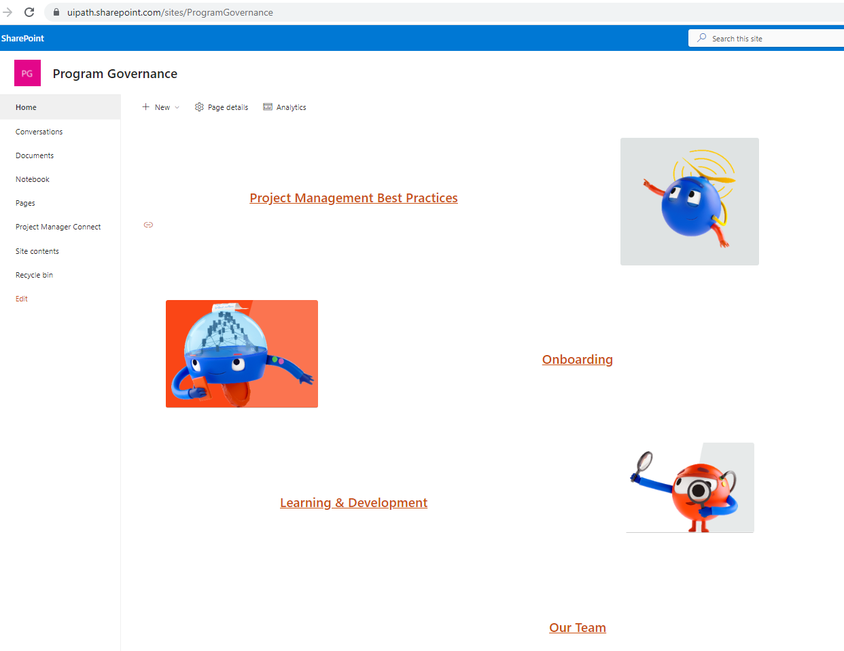
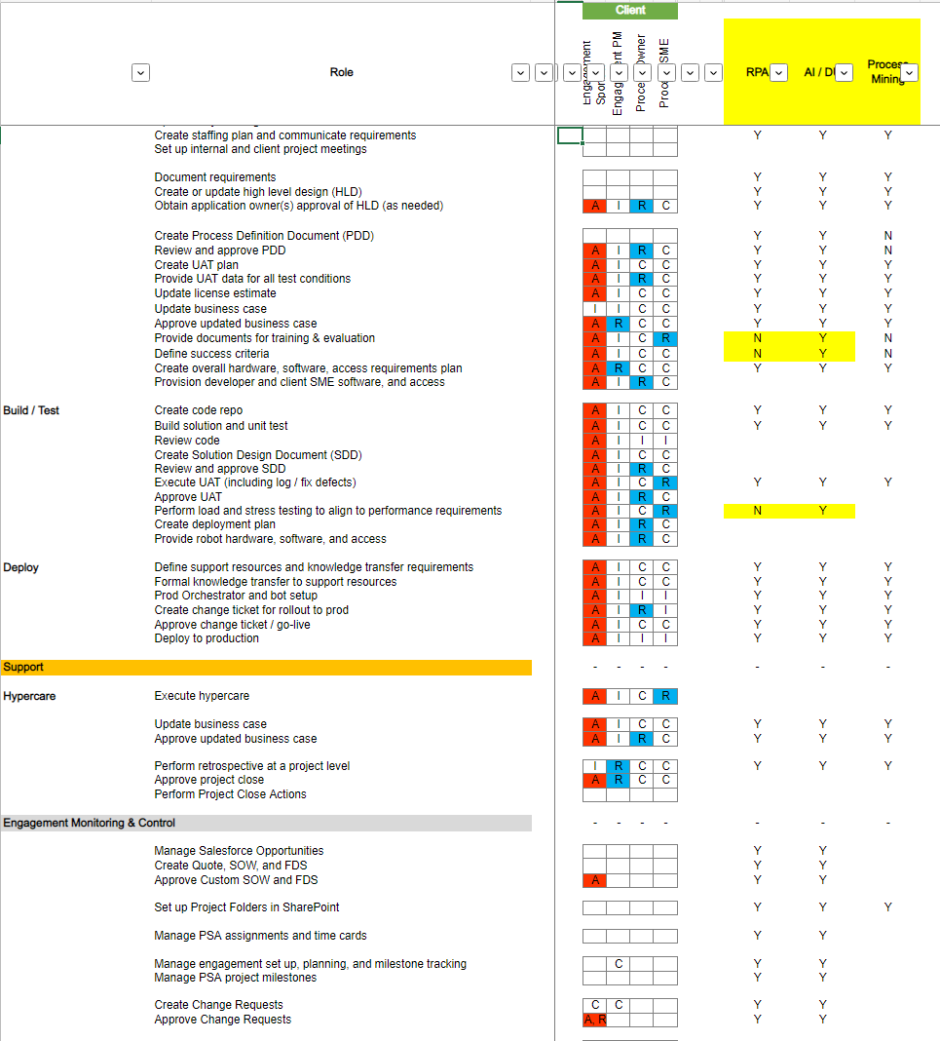
How do we execute projects? PMs collaborating/helping each other.
Professional Services

Slide 9
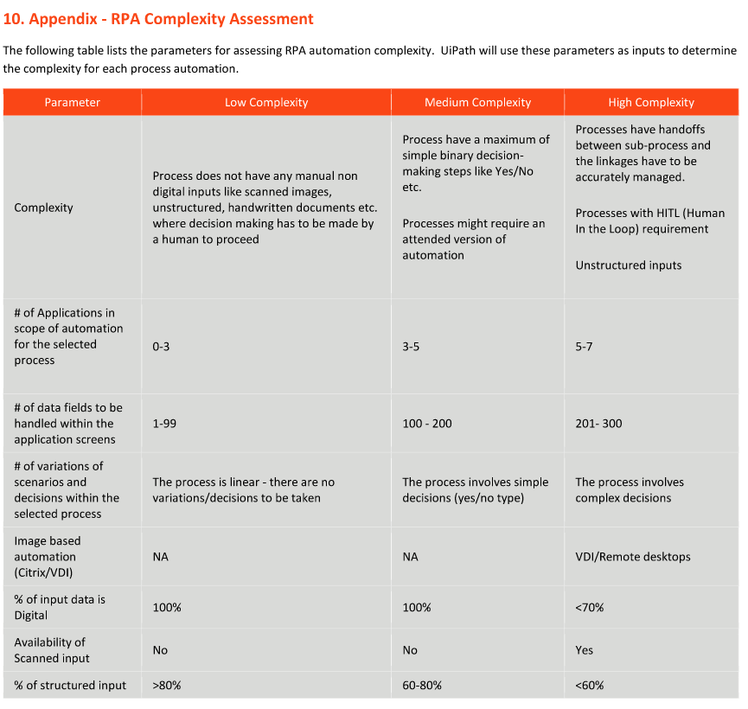
How do we execute projects? The statement of work has some guardrails.
Professional Services
… Customers may have other expectations…
Ten pounds of potatoes in a five-pound sack
Flexible, non-SOW deliverables w/o CR.
Insights, Test Suite, Task Mining, Automation Hub… All the things…

Slide 10
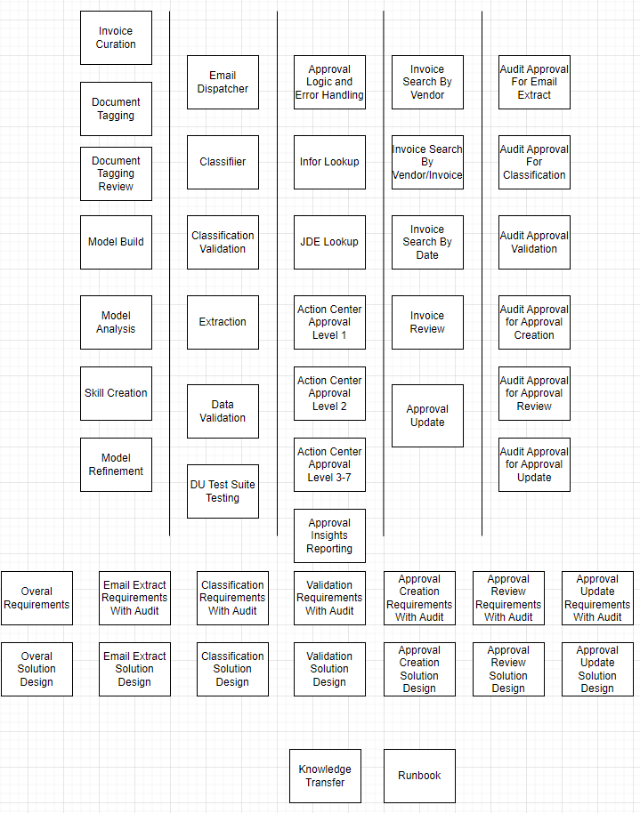
How do we execute projects? Expand and understand requirements outlined in the statement of work. Create a granular backlog and understand the dependencies and necessary collaborations. Incrementally gain customer agreements. Customer needs to know their business workflow, problem they are solving, and quickly resolve any supporting information needs. Get it in writing – status reports, recordings, signed PDD/SDD, project workbook, task lists.
Professional Services

Slide 11
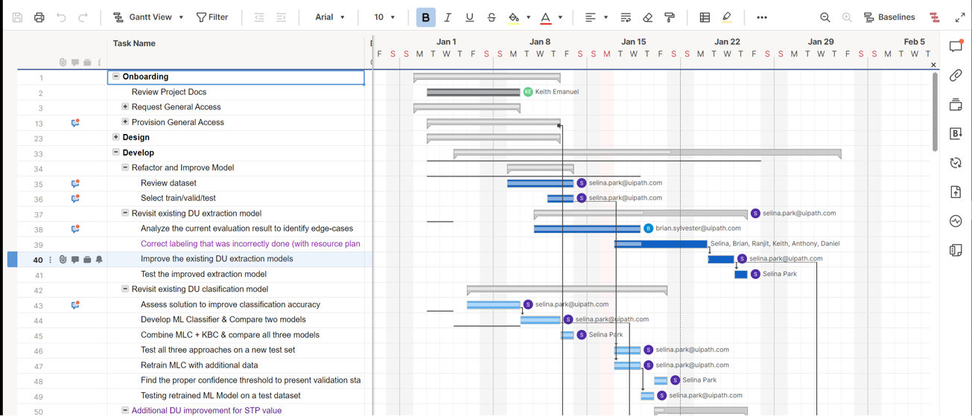
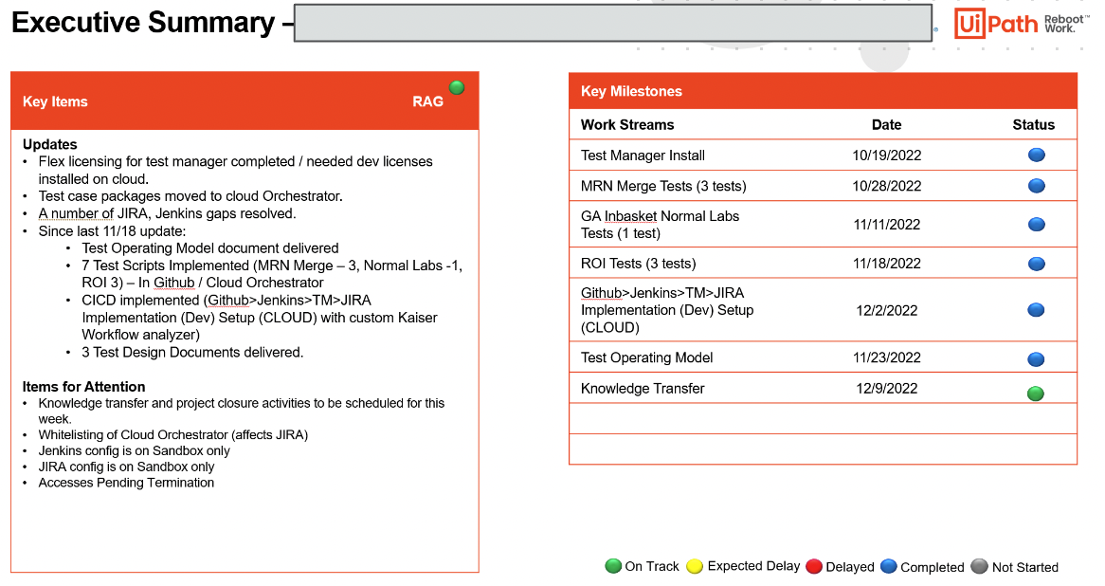
How do we execute projects? - Keep a project plan of tasks and dependencies. - Give the project sponsor options when new tasks introduced affect timeline. - Cover your "six".
Professional Services
This plan uses smartsheet.com (other tools ProjectLibre, MS Project, Trello)

Slide 12
How do we execute projects? Bring Resources At The Right Time. Watch time in PSA – don’t burn idle time. Project Manager first. ..Solution Architect. Business Analyst. …Developers, Data Scientists. It makes sense at some level to have some overlap especially if there is work developers can do prior to requirements sign-off.
Professional Services

Slide 13
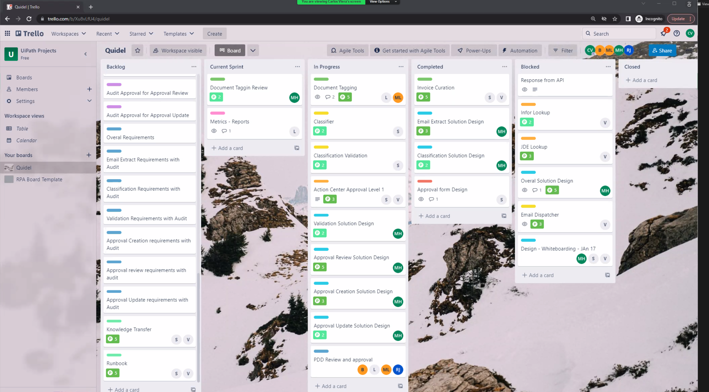
How do we execute projects? Block and Tackling, Risks, Change Requests/Difficult Discussions.
Professional Services
This Sprint board is done using Trello (other tools JIRA, Azure DevOps)
Notes:
A periodic check in with the account exec is recommended. Don't wait for a "reactive" call from your account executive. "Manage" the project and project expectations which started from the picture the account exec and presales/sales engineer impressed on your customer/sponsor.

Slide 14
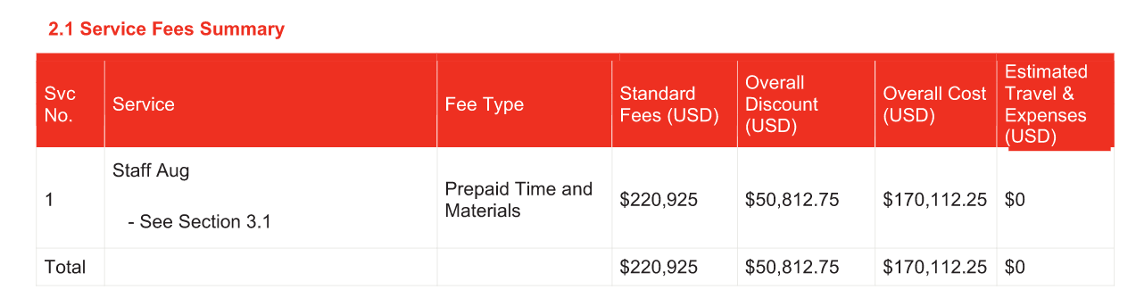
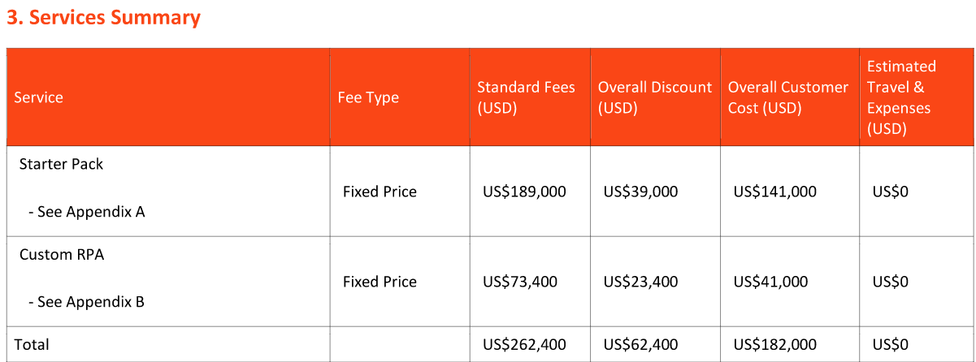
When is a project finished?
Professional Services
Project Type | Note
Time and Materials | Service Credits and Staff Aug projects can be used all at once or be stretched to an ‘expiration date’.
Fixed Price | Ends when agreed scope is signed off. Change requests that customer pays for can extend the project. Investment by UiPath can also extend the project – i.e. either z9 hours or additional cross charge from sales. Starter packs fall under this category. Revenue can be recognized at milestones i.e. Automation #1 complete, BA training complete.

Slide 15
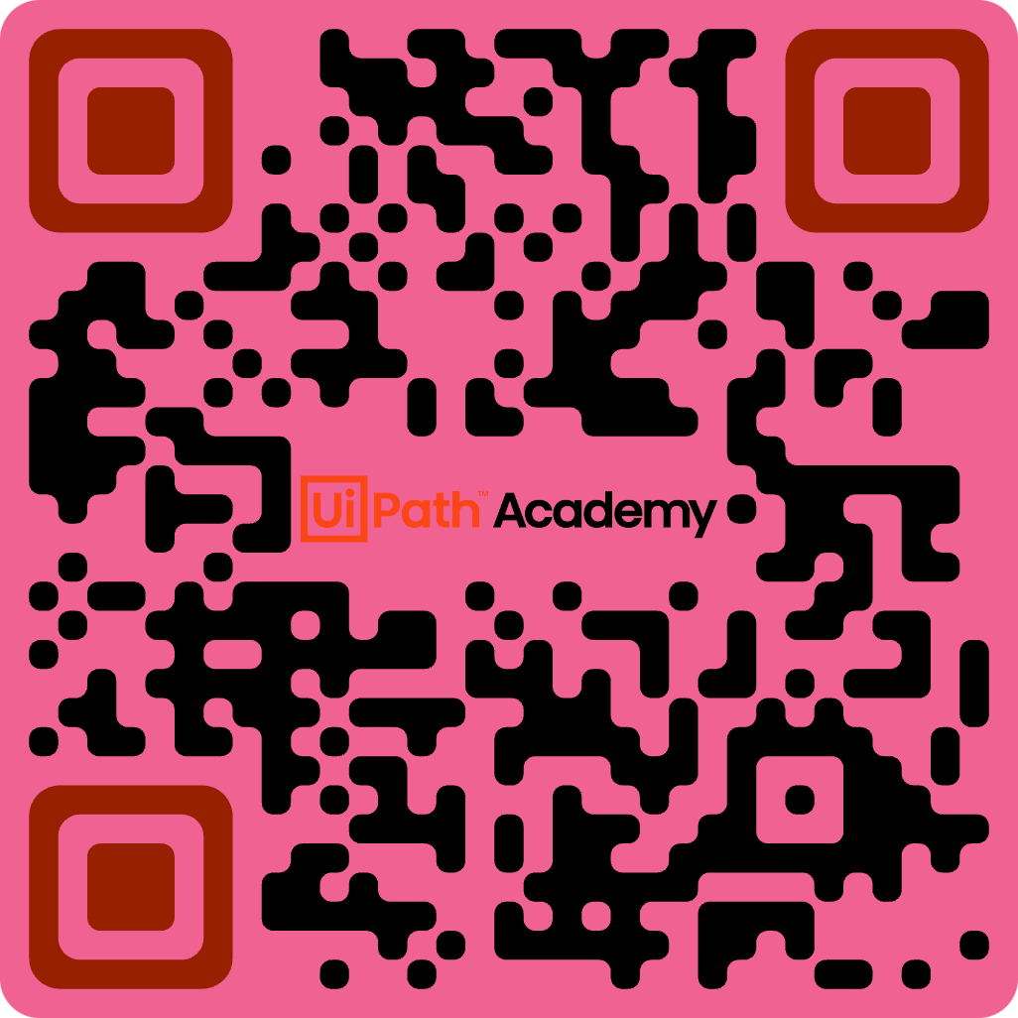
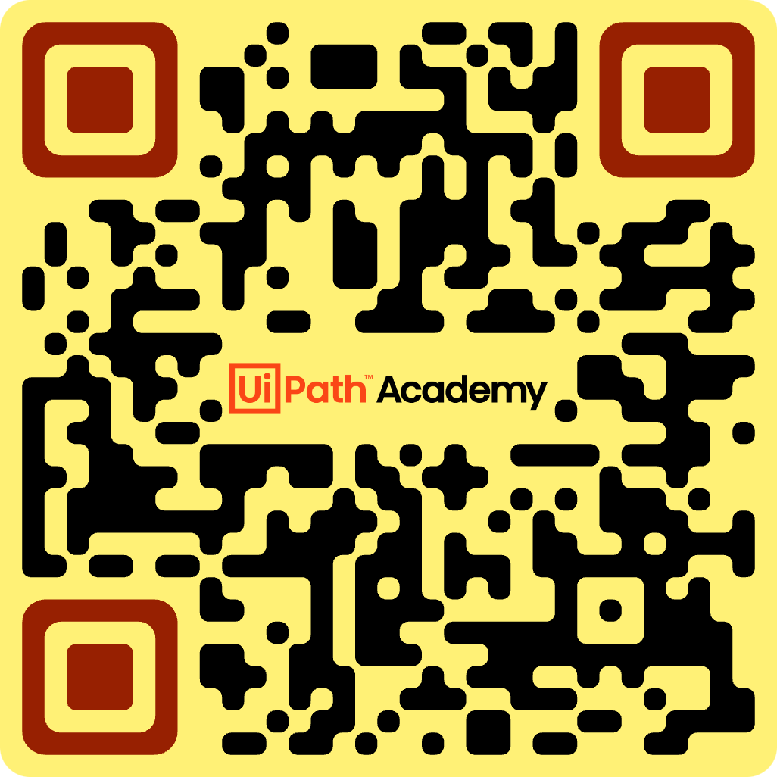
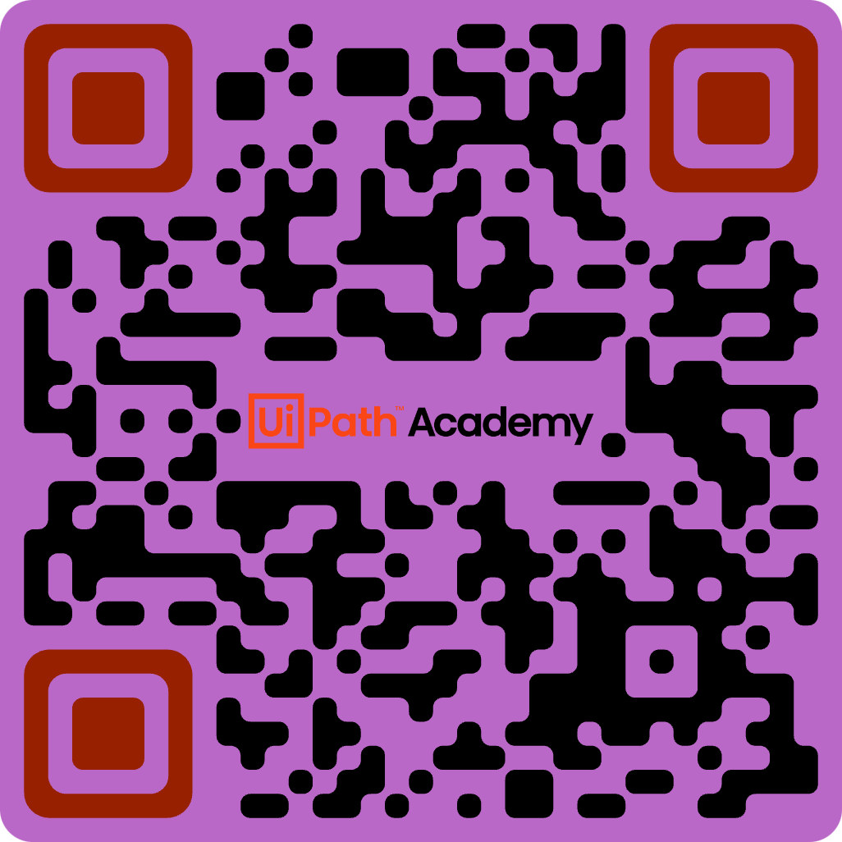

References
Professional Services
UiPath Business Analysis | UiPath Implementation Manager
UiPath RPA Development Intro | UiPath Project Manager - Explained (my github – this presentation)
Notes:
https://github.com/cognitivemetaphors/UiPathProjectManagement
https://academy.uipath.com/courses/automation-implementation-methodology-fundamentals
https://academy.uipath.com/courses/automation-business-analysis-fundamentals
https://academy.uipath.com/courses/get-started-with-rpa-development-v202010
Other courses -
https://academy.uipath.com/courses/introduction-to-rpa-developer-faststart
https://academy.uipath.com/courses/a-day-in-the-life-of-an-rpa-developer-

